Slide 1
Fidelity Scales: DACTS
The Dartmouth Assertive Community Treatment Scale
FOR URBAN TEAMS

Slide 2
What is Fidelity
A central function of a fidelity measure is to distinguish programs conforming to the ideal from those conforming to norms for the corresponding conventional treatment
Set to a scale
The lowest anchors are set to an estimated minimal value of typical case-management based services
Fidelity helps provide a consistency in the provision of care within and across agencies

Slide 3
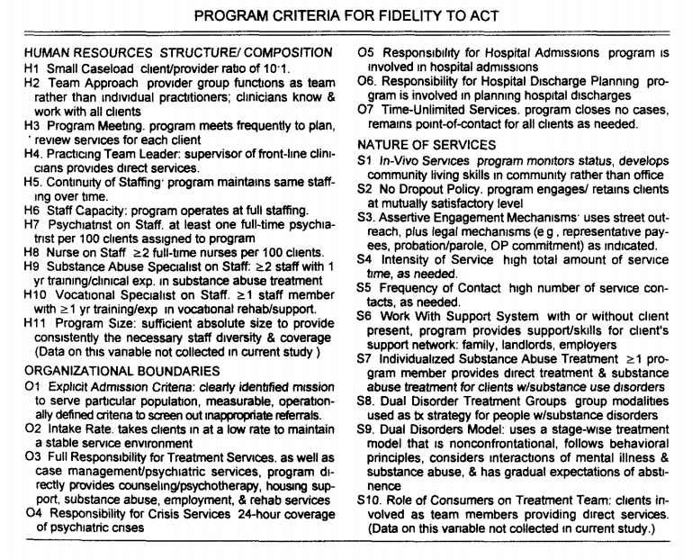
Program Criteria for Fidelity to ACT

Slide 4
Fidelity: Structure and Content

Slide 5
Dimension 1: Human Resources
Addresses composition and structure of staffing:
Ratio of clients to staff
Team functioning
Caseload sharing
Regular meetings
Leadership by practicing clinician
Specific disciplines or specialized staffing
Physician
Nurse
Substance abuse
Full and continuous staffing is specified because failure to achieve it seriously compromises program functioning

Slide 6
Dimension 2: Organizational Boundaries
Addresses program responsibility and relationships with other programmatic components
Specificity of admission criteria
Rate at which the program takes on new clients
Responsibility for specific types of rehabilitative and crisis services
Movement in and out of hospitals
Commitment to unlimited services, as needed

Slide 7
Dimension 3: Nature of services
Addresses the range and nature of services and overall treatment approach
Criteria specify services in the community
Outreach and follow-up to maintain clients in service
Explicit use of assertive engagement techniques
Intensive and frequent services, as needed
Staff working with client’ support systems
Treatment for substance abuse problems, as needed

Slide 8
Item Anchors and Scoring

Slide 9
Tools used by raters
Information to be used in making ratings comes from a variety of sources:
Reports of program behavior from program supervisors or staff
Documents reflecting:
Program authority
Responsibility
Policies and procedures
Chart review
Staffing
Clientele
Services
Direct structured interviews

Slide 10
Using the Scale to Evaluate Your Program

Slide 11
Evaluation Process
General assessments include:
Interviews with administrators, the ACT leader, ACT team members, and consumers and families
Observation of team meetings
Chart review

Slide 12
Documentation Needed
Roster of ACT team members (roles, full-time equivalents)
Staff vacancies each month for the last 6 months (or as long as the program has existed if less than 6 months)
Number of people who have left the team during the last 2 years (or since program started if less than 2 years old)
Written description of the team’s admission criteria
Roster of ACT consumers
Number of consumers with co-occurring disorders

Slide 13
Documentation Needed Cont.
Number of patients admitted to ACT program, per month, for the last 6 months
How many patients ended their involvement with the program in the last 6 months, broken down by:
Graduated
Relocated out of service area
Closed because they refused services or team cannot find them
Deceased
Other (explain)
Last 10 patients admitted to psychiatric hospital
Last 10 patients discharged from psychiatric hospital
Number of patients living in group homes
Number of patients who ACT team has contacted their informal support network (e.g. family member, landlord) at least once

Slide 14
Scale Categories: Human Resources

Slide 15
Scale Categories: Human Resources Cont.

Slide 16
Human Resources: Small Caseload
Definition: Patient/team member ration of 10:1
Rationale: Act teams should maintain a low patient-to-staff ratio in the range of 10:1 to ensure adequate intensity and individualization of services
Assessment: Current counts of caseload for all active patients (have a standard definition of active) and count of all team members who provide direct services (exception of psychiatrist/prescriber)
Do not count team members who are technically employed by team but have been on extended leave of 3 months or more

Slide 17
Human Resources: Team Approach
Definition: Provider group functions as a team; team members know and work with all consumers
Rationale: The entire team shares responsibility for each consumer; each team member contributes expertise as appropriate. The team approach ensures continuity of care for patients and creates a supportive organizational environment for team members
Assessment: Count of number of ACT team members who have face-to-face contact with patient during specified time & percentage of patients who have seen more than 1 team member in the specified period

Slide 18
Human Resources: Program Meeting
Definition: Program meets frequently to plan and review services for each patient
Rationale: Daily team meetings allow ACT team members to discuss patients, solve problems, and plan treatment and rehabilitation efforts, ensuring all consumers receive optional service
Assessment: Frequency of team meetings with full group & number of patients reviewed at each meeting
If the team meets at least 4 days a week and reviews each patient each time, score of 5. If team meets at least 4 days a week but does not review each patient each time, score of 4

Slide 19
Human Resources: Practicing ACT Leader
Definition: Supervisor of ACT team members provides direct services
Rationale: Research has shown this factor was among the 5 most strongly related to patient outcomes. ACT leaders who also have direct clinical contacts are better able to model appropriate clinical interventions and remain in touch with the patients serviced by the team
Assessment: Does the leader provide direct service and if so the percentage of time
At least 50% of time dedicated to direct service, score 5

Slide 20
Human Resources: Continuity of Staffing
Definition: Program maintains the same staffing over time
Rationale: Maintaining a consistent staff enhances team cohesion; additionally, consistent staffing enhances the therapeutic relationships between patients and providers
Assessment: The number of individuals who have left the team over a period of 2 years
If the annual turnover rate is 10% or less, score 5

Slide 21
Human Resources: Staff Capacity
Definition: Program operates at full staffing
Rationale: Maintaining consistent, multidisciplinary services requires minimal positon vacancies
Assessment: Number of unfilled positions for each month over previous year (excluding administrative support staff)
Program operating at 95% or more of full staffing capacity of past 12 months, score 5

Slide 22
Human Resources: Prescriber on Staff
Definition: For 100 patients, at least 1 FTE prescriber is assigned to work with the program
Rationale: The prescriber serves as medical director for the team. In addition to medication monitoring, the prescriber functions as a fully integrated team member, participating in treatment planning and rehabilitation efforts
Assessment: Active number of patients to FTE prescriber & accessibility for patients to prescriber

Slide 23
Human Resources: Nurse on Staff
Definition: At least 2 FTE nurses are assigned to work with a 100-patient program
Rationale: The FTE RN has been found to be a critical ingredient in successful ACT programs. The nurses function as members of the team, which includes conducting home visits, treatment planning, and daily team meetings. Nurses can help administer needed medications and serve to educate the team about important medication issues
Assessment: Active number of patients to FTE nurses, participation with team, & accessibility for patients to nurses

Slide 24
Human Resources: Substance Use Specialist on Staff
Definition: At least 2 staff members on the ACT team with at least 1 year of training or clinical experience in substance abuse treatment, per 100 patient program
Rationale: Concurrent substance-use disorders are common for patients. Appropriate assessment and intervention strategies are critical
Assessment: Active number of patients to FTE qualified professionals, participation with team, & accessibility for patients to qualified professionals

Slide 25
Human Resources: Supportive Employment Specialist*
Definition: Program includes at least 2 staff members with at least 1 year of training/experience in vocational rehabilitation and support
Rationale: ACT teams emphasize skill development and support in natural settings. Fully integrated ACT teams include supportive employment services that enable patients to find and keep jobs in integrated work settings.
Assessment: Active number of patients to FTE employment specialist & accessibility for patients to employment specialist
*Full credit may be given even if the employment specialist belongs to a separate team/organization based on time spent with ACT patients

Slide 26
Human Resources: Program Size
Definition: Program is of sufficient size to consistently provide necessary staffing diversity and coverage.
Rationale: The ACT team provides an integrated approach to mental health services, through which the range of treatment issues are addressed from a variety of perspectives. It is critical to maintain adequate staff size and disciplinary background to provide comprehensive, individualized service to each patient
Assessment: Number of FTE staff and specializations
If program has at least 10 FTE staff, score of 5
Does not include administrative staff

Slide 27
Scale Categories: Organizational Boundaries

Slide 28
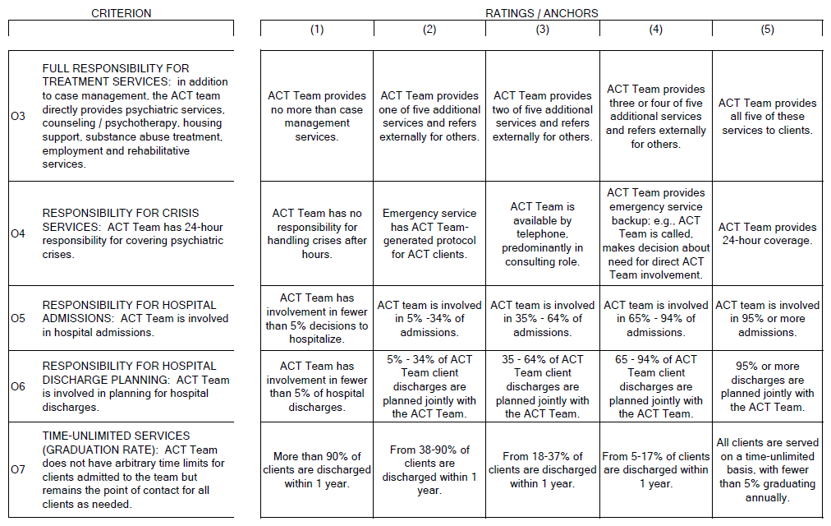
Scale Categories: Organizational Boundaries Cont.

Slide 29
Organizational Boundaries: Explicit Admission Criteria
Definition: The program has clearly identified mission to serve a particular population; it uses measurable and operationally defined criteria to screen out inappropriate referrals. Admission criteria should be pointedly targeted toward patients who typically do not benefit from usual services. ACT teams are intended for adults with serious mental illness. In addition to those very general criteria, an ACT team should have further admission guidelines tailored to their treatment settings
Rationale: ACT is best suited to patients who do not effectively use less intensive mental health services
Assessment: Documented well defined population & patients meet admission criteria

Slide 30
Organizational Boundaries: Intake Rate
Definition: Program takes consumers in at a low rate to maintain a stable service environment
Rationale: To provide consistent, individualized, and comprehensive services to patients, a low growth rate of the patient population is necessary
Assessment: If the highest monthly intake rate during previous 6 months is no greater than 6 patients, score 5

Slide 31
Organizational Boundaries: Full Responsibility for Treatment Services
Definition: ACT team directly provides psychiatric services and medication management, counseling/psychotherapy, housing support, substance abuse treatment, and employment/rehabilitative services, in addition to case management services
Rationale: Patients benefit when services are integrated into a single team, rather than when they are referred to many different service providers. Furthermore, an integrated approach allows services to be tailored to each patient
Assessment: Services provided in house versus referred out
If team is responsible for 90% or more of each type of services for patients, score 5

Slide 32
Organizational Boundaries: Responsibility for Crisis Services
Definition: Program has 24-hour responsibility for covering psychiatric crises
Rationale: An immediate response can help minimize distress when patients are faced with crisis. When the ACT team provides crisis intervention, continuity of care is maintained
Assessment: If a team member is on call at all times, score 5. If notified through general crisis line reliably, score 4

Slide 33
Organizational Boundaries: Responsibility for Hospital Admissions
Definition: ACT team is closely involved in hospital admissions
Rationale: More appropriate use of psychiatric hospitalization occurs and continuity of care is maintained when the ACT team is involved with psychiatric hospitalizations
Assessment: Percentage of admissions ACT team was involved with
95% or more of all admissions in which ACT team was involved, score 5

Slide 34
Organizational Boundaries: Responsibility for Hospital Discharge Planning
Definition: Program is involved in planning for hospital discharges
Rationale: Ongoing participation of the ACT team during a patient’s hospitalization and discharge planning allows the team to help maintain community supports and continuity of service
Assessment: Percentage of discharges ACT team was involved with
95% or more of all discharges in which ACT team was involved, score 5

Slide 35
Organizational Boundaries: Time-Unlimited Services/Graduation Rate
Definition: Program does not have arbitrary time limits for patients admitted to the program cases but remains the point of contact for all patients indefinitely as needed
Rationale: Patients often regress when they are terminated from short-term programs. Time-unlimited services encourage the development of stable, ongoing therapeutic relationships
Assessment: Percentage of patients discharged (only those that graduated)
Fewer than 5% are expected to graduate annually, score 5

Slide 36
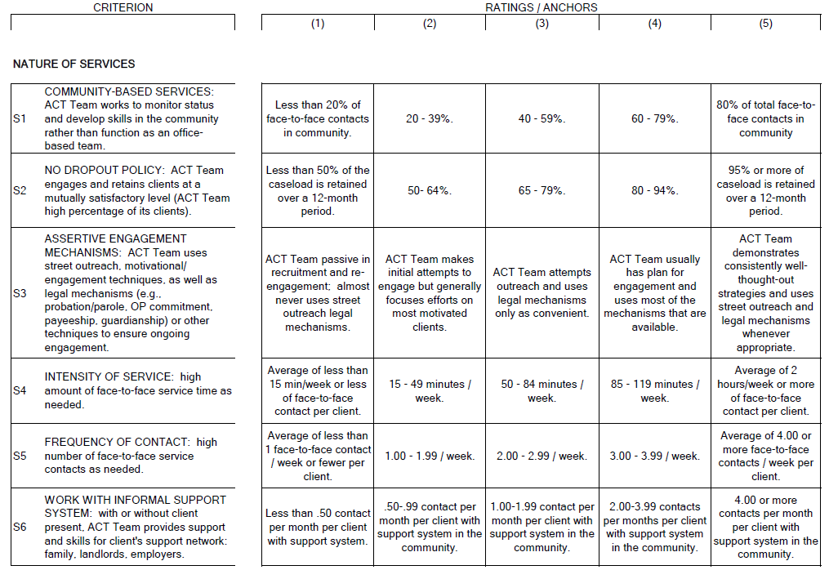
Scale Categories: Nature of Services

Slide 37
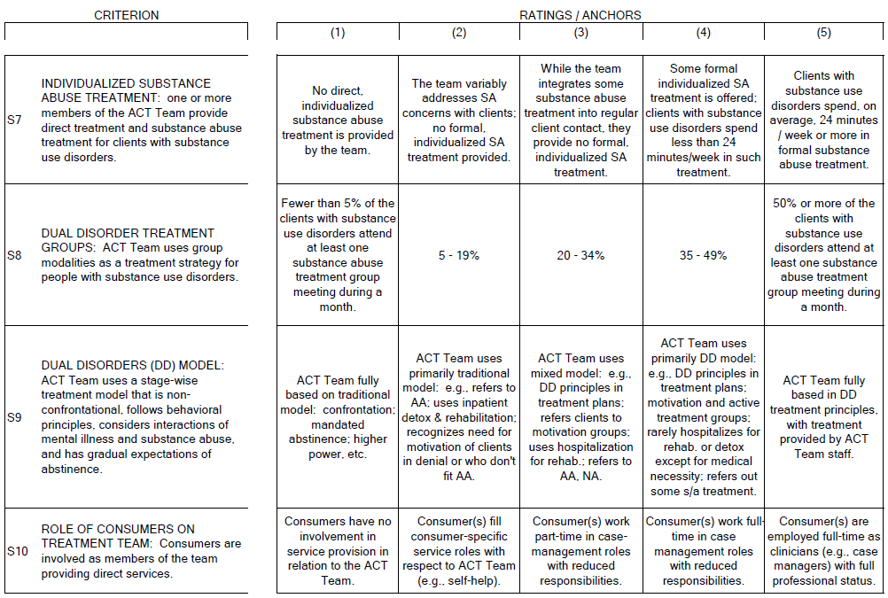
Scale Categories: Nature of Services

Slide 38
Nature of Services: Community-Based Services
Definition: Program works to monitor status and develop skills in the community, rather than function as an office-based program
Rationale: Contacts in natural settings are thought to be more effective than when they occur in hospital or office settings because skills may not transfer well to natural settings. Furthermore, more accurate assessments of consumers can occur in their community setting because the team member can directly observe rather than relying on self-report. Medication delivery, crisis intervention, and networking are more easily accomplished through home visits
Assessment: Percentage of face-to-face interactions with patients in the community
At least 80% of total service time occurs in the community, score 5

Slide 39
Nature of Services: No Dropout Policy
Definition: Program engages and retains patients at a mutually satisfactory level
Rationale: Outreach efforts, both initially and after patients are enrolled on an ACT team, help build relationships and ensure patients receive ongoing services
Assessment: Number of people who refused services, cannot be located, have been deemed inappropriate for services, or have moved outside of service area (that referrals were not given for)
95% or more retention over 12 month period, score 5

Slide 40
Nature of Services: Assertive Engagement Mechanisms
Definition: Program uses street outreach, legal mechanisms, or other techniques to ensure ongoing engagement
Rationale: Patients are not immediately discharged from the program due to failure to keep appointments. Retention of patients is a high priority for ACT teams. Persistent, caring attempts to engage patients in treatment help foster a trusting relationship between the consumer and the ACT team. Assertive outreach is considered a critical feature of the ACT team
Assessment: Demonstration of well-thought-out strategies for outreach and utilization when appropriate

Slide 41
Nature of Services: Intensity of Service
Definition: High amount of face-to-face service time, as needed
Rationale: To help patients with serious symptoms maintain and improve their function within the community, high service intensity is often required
Assessment: Number and length of face-to-face contacts with patients
Median value is 2 or more hours per week, per patient, score 5

Slide 42
Nature of Services: Frequency of Contact
Definition: High amount of face-to-face service contacts, as needed
Rationale: ACT teams are highly invested in their patients and maintain frequent contact to provide ongoing, responsive support as needed. Frequent contacts are associated with improved patient outcomes
Assessment: Number of face-to-face contacts with patients
Median value is 4 or more contacts per week, per patient, score 5

Slide 43
Nature of Services: Work With Informal Support System
Definition: Program provides support and skills for patients’ informal support network (those not paid to assist)
Rationale: Developing and maintain community support further enhances patients’ integration and functioning
Assessment: The number of support contacts the team has & the number of times they are contacted within a given month
4 or more contacts per month, per patient, code as 5

Slide 44
Nature of Services: Individualized Substance Abuse Treatment
Definition: One or more members of the team provide direct treatment and substance abuse treatment for patients with substance use disorders
Rationale: Substance use disorders often occur concurrently in consumers with serious mental illnesses; these co-occurring disorders require treatment that directly addresses them
Assessment: Number of patients with substance use disorders & the number of those that received structured substance use treatment

Slide 45
Nature of Services: Co-occurring Disorder Treatment Groups
Definition: Program uses group modalities as a treatment strategy for people with substance use disorders
Rationale: Group treatment has been shown to positively influence recovery for patients with dual disorders
Assessment: Number of patients identified with dual diagnosis attended group with the previous month
50% or more of all patients with substance use disorders attend at least 1 substance abuse treatment group meeting in the previous month, score 5

Slide 46
Nature of Services: Co-occurring Disorders Model
Definition: Program uses a non-confrontational, stage wise treatment model, follows behavioral principles, considers interactions between mental illness and substance abuse, and has gradual expectations of abstinence
Rationale: The co-occurring disorders model attends to the concerns of both SMI and substance abuse for maximum opportunity for recovery and symptom management
Assessment: Program is based in dual-diagnosis treatment principles, with the team providing treatment, score 5

Slide 47
Nature of Services: Role of Peers on Treatment Team
Definition: Peers are members of the team who provide direct services
Rationale: Some research has concluded that including peers as team members on case management teams improves the practice culture, making it more attuned to patients’ perspectives
Assessment: If peers are employed as ACT team members with equal status as other case managers, score 5

